Slide 1
xTEST
By
Achieve Test Excellence

Slide 2
xTEST
A driver base solution to achieve artificial intelligence
Provides four major functions:
xREPROBE Patent: TW I639846
xCLEANING
Provides auto calculated reprobing path to minimize rescreen test time and maximize recovery yields
Provides proactive control in cleaning to
  Maintain target yield
  Provide maximum throughput by only cleaning when needed
xSETUP
xDATA
Auto-Z to setup prober for production environment and adjust overdrive on the fly
Provides real time data analysis for alert or monitoring
Setup data stream to any database upon request

Slide 3
xREPROBE
Patent: TW I639846

Slide 4
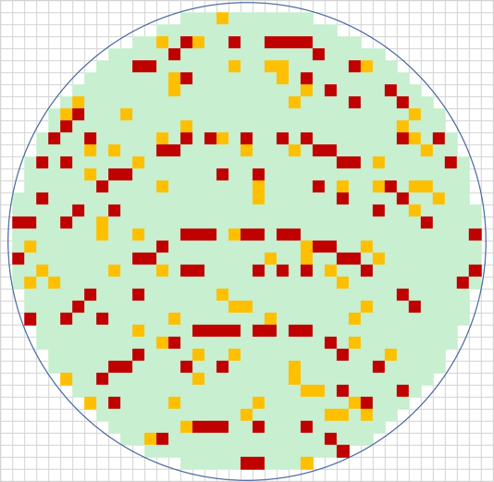
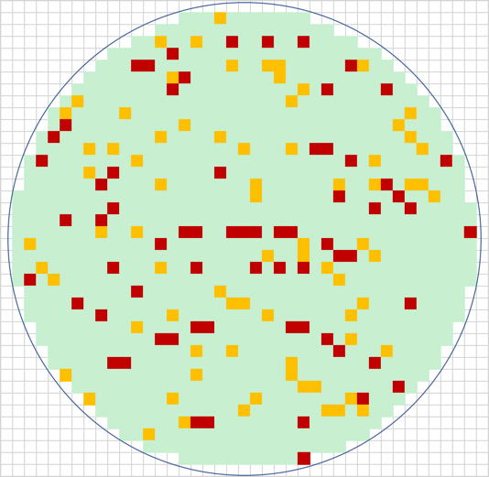
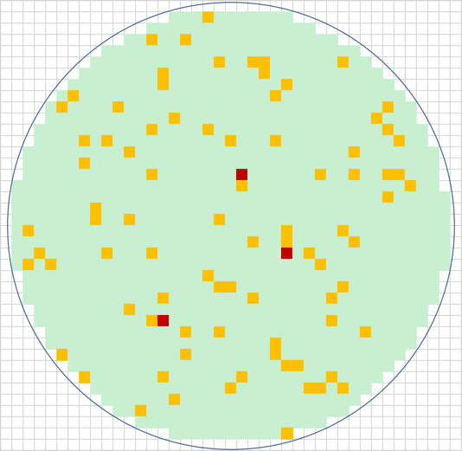
Probe Production Flow
Next Step
How long does it take?
Pass
1st Pass
Inline
Retest
Yield
Check
Disposition
Offline
Retest
Fail

Slide 5
What happened?
Low site to site yield from first pass to inline retest
First Pass:
Site | FirstPass | Inline Retest
All | 82.63% | 87.60%
0 | 91.93% | 91.93%
1 | 92.45% | 92.45%
2 | 37.25% | 62.75%
3 | 96.03% | 96.03%
4 | 89.66% | 89.66%
5 | 72.41% | 85.52%
6 | 92.19% | 92.19%
7 | 91.34% | 91.34%
Inline Retest:

Slide 6
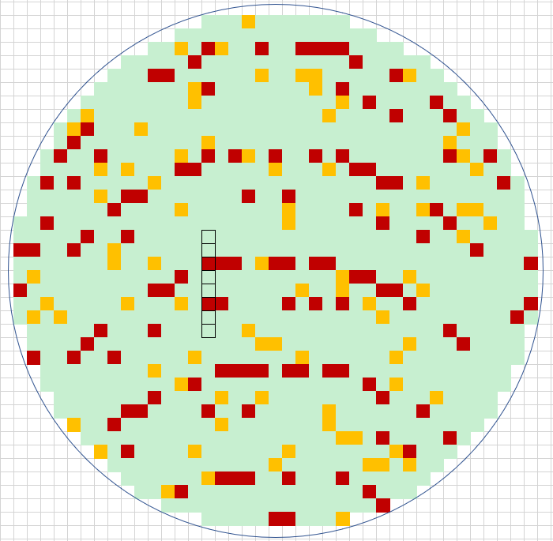
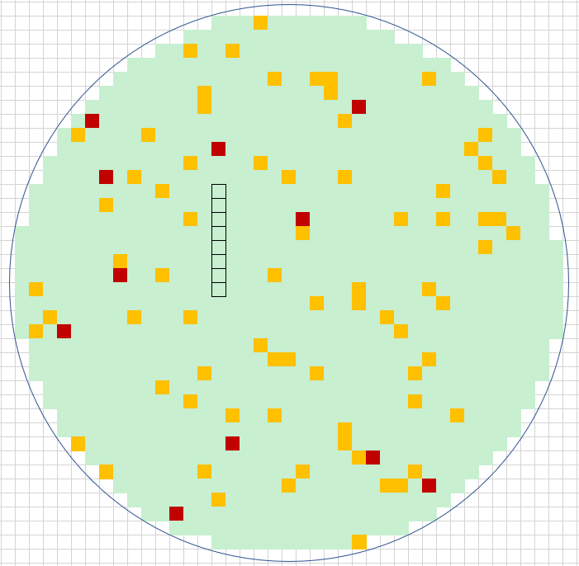
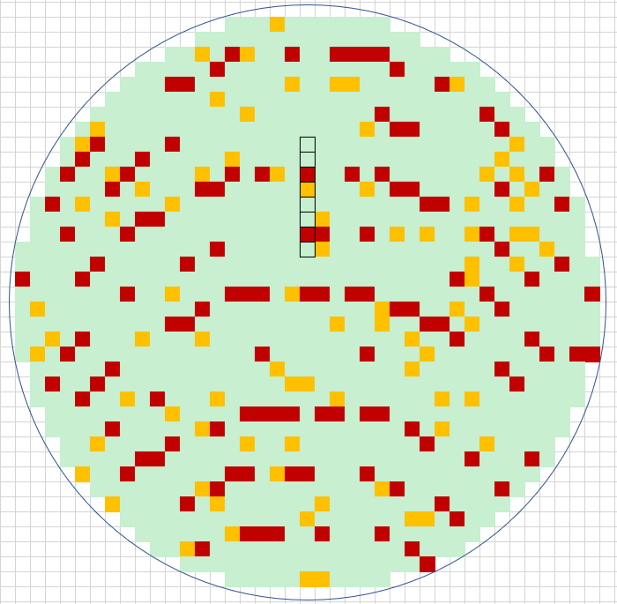
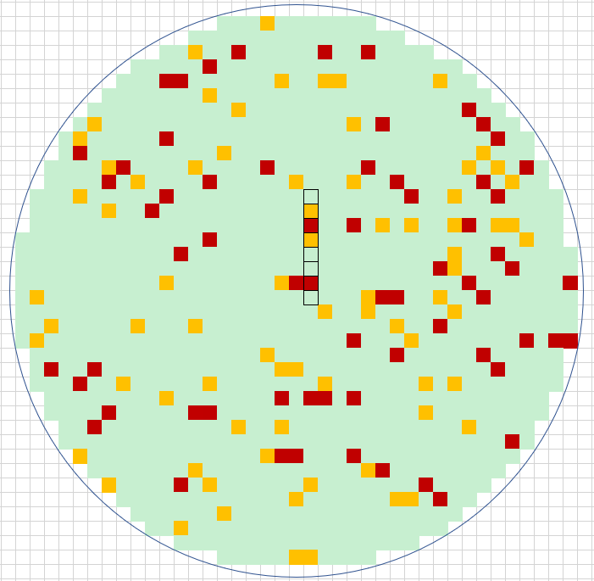
Blind Shift Site Reprobe:
Non-overlapping: Low Yield S2 & S5, retested with S6 & S0
Blind shift site reprobe on prober
  Pre-defined 2nd step map
  Fixed shift site location
Cons:
  Need to setup for each device
  Wafer stepping optimization lost
  Performance may differ base on low yield site locations
Overlapping: Low Yield S2 & S6, retested with S6 & S2

Slide 7
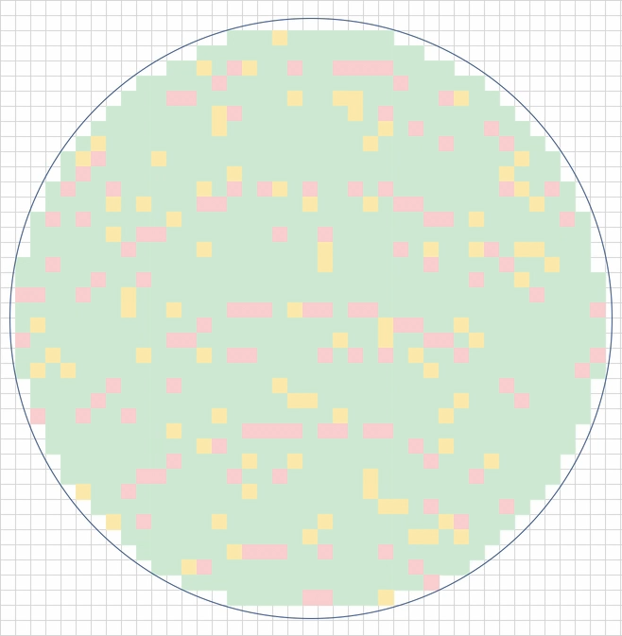
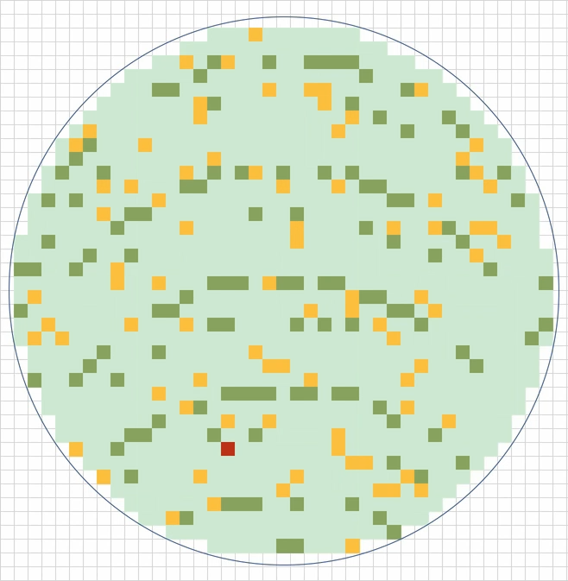
Intelligent Reprobe
We called xREPROBE, use best yielding sites
Patented : TW I639846 ; Pending in US and others
Calc 1st Yield
Select Best Probing Coordinates
Move to calculated Retest Location
Retest Done?
Wafer End
1st Pass
(Follow Prober Stepping)
 | FirstPass
Yield | 82.63%
Site 0 | 91.93%
Site 1 | 92.45%
Site 2 | 37.25%
Site 3 | 96.03%
Site 4 | 89.66%
Site 5 | 72.41%
Site 6 | 92.19%
Site 7 | 91.34%

Slide 8
Methodology
1st step: Optimize for retest time
  Find location to test as many as rejects as possible
  Among the possible shifts, pick the best sites to retest
2nd step: Optimize for retest yield
  If chances to recover are low, look for other shift testing fewer rejects
  Rules include:
    Possible recovery yield control
    Retested with bad site

Slide 9
How Do We Decide? - Optimize Retest Time
Options we have for retest on example (1x8 PH), to test all rejects
S0
S1
S2
S3
S4 | 89.66%
S5 | 72.41%
S6
S7 | 91.34%
Site | 1st Yield
0 | 91.93%
1 | 92.45%
2 | 37.25%
3 | 96.03%
4 | 89.66%
5 | 72.41%
6 | 92.19%
7 | 91.34%
Best
Choice!
S0
S1
S2
S3 | 96.03%
S4 | 89.66%
S5
S6 | 92.19%
S7
S0
S1
S2 | 37.25%
S3 | 96.03%
S4
S5 | 72.41%
S6
S7
S0
S1 | 92.45%
S2 | 37.25%
S3
S4 | 89.66%
S5
S6
S7
S0 | 91.93%
S1 | 92.45%
S2
S3 | 96.03%
S4
S5
S6
S7
Opportunity for Recover:
Avg: 93.47%
Avg: 73.12%
Avg: 68.56%
Avg: 92.63%
Avg: 84.47%

Slide 10
How Do We Decide? - Optimize Retest Yield
S0
S1
S2
S3
S4
S5
S6
S7 | 72.41%
S0
S1
S2
S3
S4
S5
S6 | 78.19%
S7
Avg: 67%
Avg: 85.32%
Avg: 82.17%
S0
S1
S2
S3
S4
S5 | 91.34%
S6
S7
Site | 1st Yield
0 | 37.25%
1 | 92.45%
2 | 91.93%
3 | 96.03%
4 | 89.66%
5 | 91.34%
6 | 78.19%
7 | 72.41%
S0
S1
S2
S3
S4 | 89.66%
S5
S6
S7
S0
S1
S2
S3 | 96.03%
S4
S5
S6
S7
Only
Choice?
Or go
Beyond?
S0
S1
S2 | 91.93%
S3
S4
S5
S6
S7 | 72.41%
S0
S1 | 92.45%
S2
S3
S4
S5
S6 | 78.19%
S7
S0 | 37.25%
S1
S2
S3
S4
S5 | 91.34%
S6
S7 | 72.41%

Slide 11
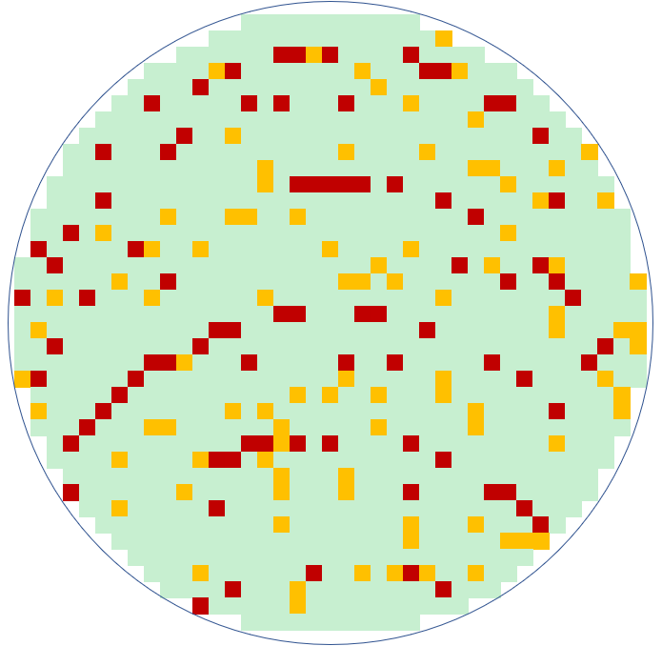
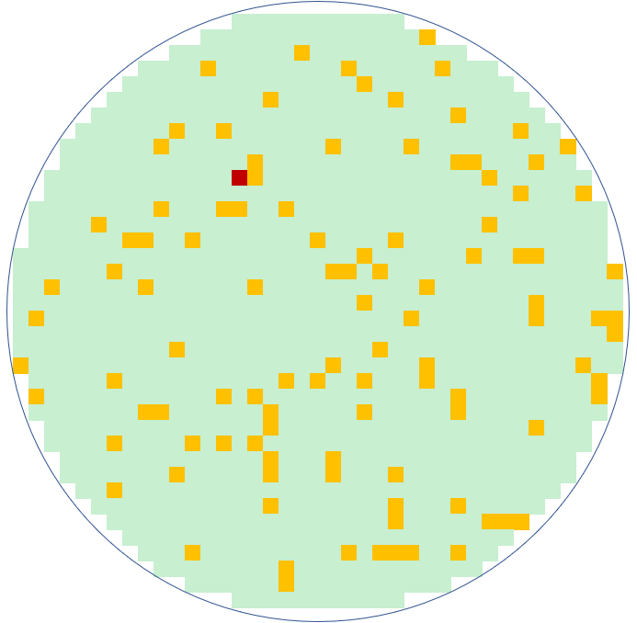
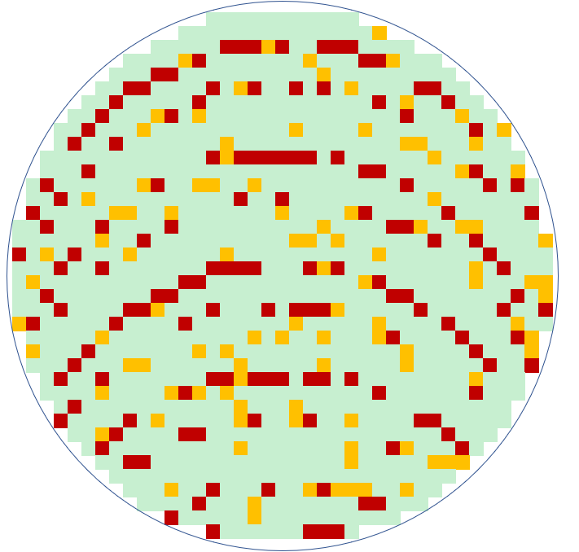
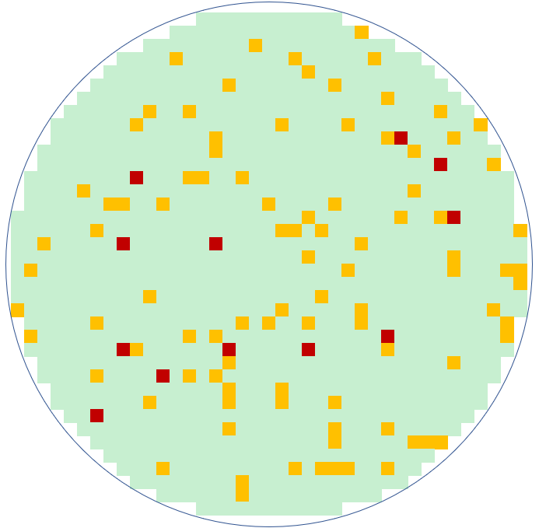
Result Comparison –
Low Yield on none overlap sites
Retest Options
Yield
6.08%️↑
xREPROBE vs Traditional:
Traditional
xREPROBE
First Pass
 | FirstPass | Retest Options
 |  | Traditional | Blind Shift | xREPROBE
Yield | 78.36% | 84.77% | 90.93% | 90.85%
0 | 92.55% | 12 ① | 16 | 59
1 | 93.08% | 11 | 62 | 80
2 | 26.80% | 112 | 12 | 0
3 | 92.05% | 12 | 16 | 47
4 | 88.97% | 16 | 12 | 19
5 | 57.24% | 62 | 11 | 3
6 | 90.63% | 12 | 112 | 29
7 | 87.40% | 16 | 12 | 16
TD | 161 | 141② | 160 | 128
RedCnt | 147 | 85 | 12 | 1
RedPct | 12.57% | 7.27% | 1.03% | 0.09%
Blind Shift
①: Number represents number of rejects tested
②: Number represents number of touch downs
Test Time
4.3%↓

Slide 12
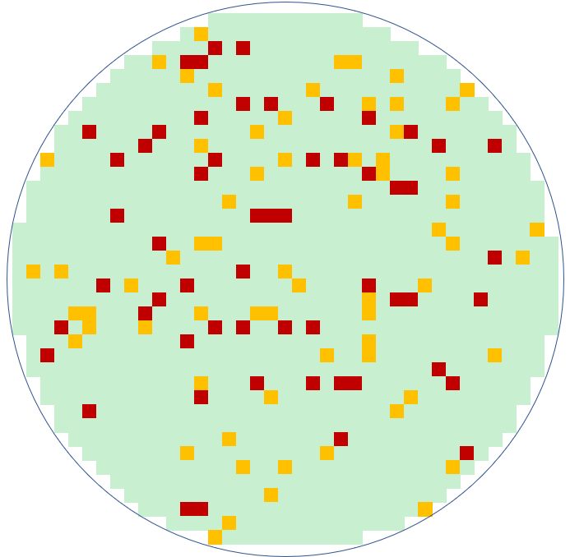
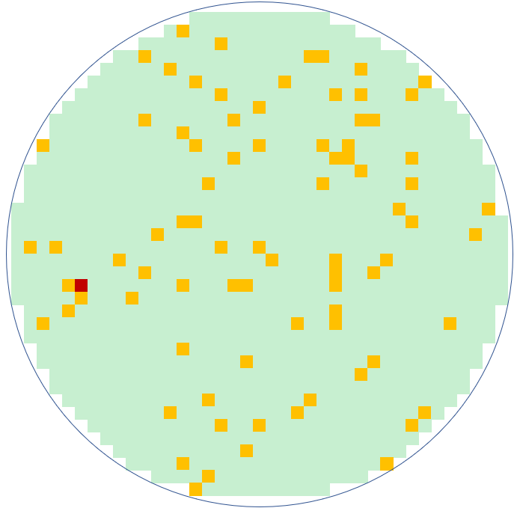
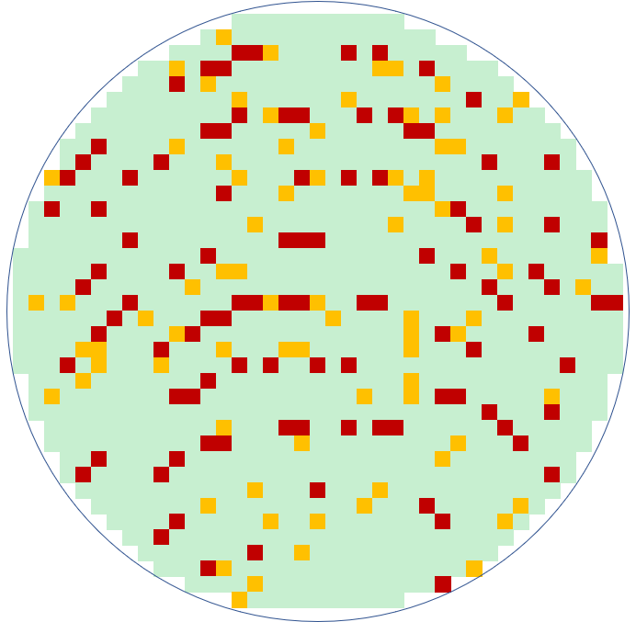
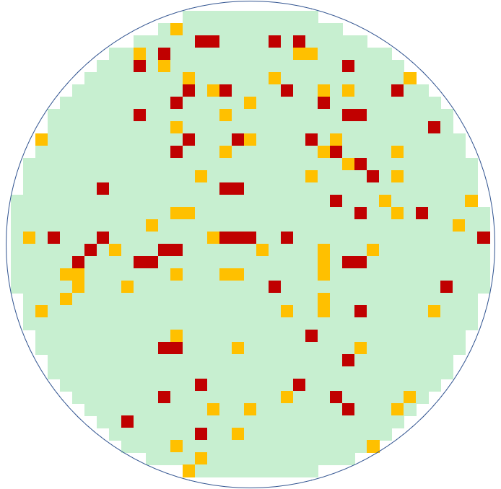
Result Comparison –
Low Yield on overlap sites
Retest Options
Yield
3.6%️↑
xREPROBE vs Traditional:
Traditional
xREPROBE
First Pass
 | FirstPass | Retest Options
 |  | Traditional | Blind Shift | xREPROBE
Yield | 84.26% | 89.39% | 89.39% | 92.99%
0 | 91.30% | 14① | 7 | 14
1 | 96.23% | 6 | 8 | 83
2 | 53.59% | 71 | 61 | 3
3 | 94.04% | 9 | 8 | 11
4 | 95.17% | 7 | 14 | 12
5 | 94.48% | 8 | 6 | 38
6 | 52.34% | 61 | 71 | 2
7 | 93.70% | 8 | 9 | 21
TD | 161 | 112② | 121 | 99
RedCnt | 102 | 57 | 59 | 1
RedPct | 8.73% | 4.88% | 5.05% | 0.09%
Blind Shift
①: Number represents number of rejects tested
②: Number represents number of touch downs
Test Time
4.7%↓

Slide 13
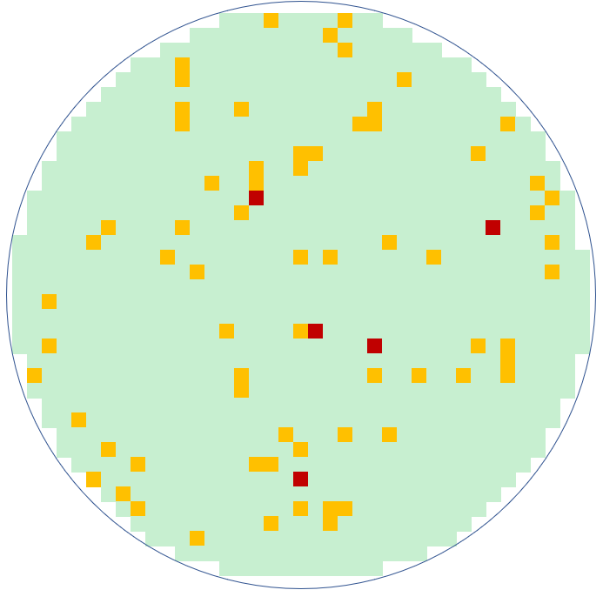
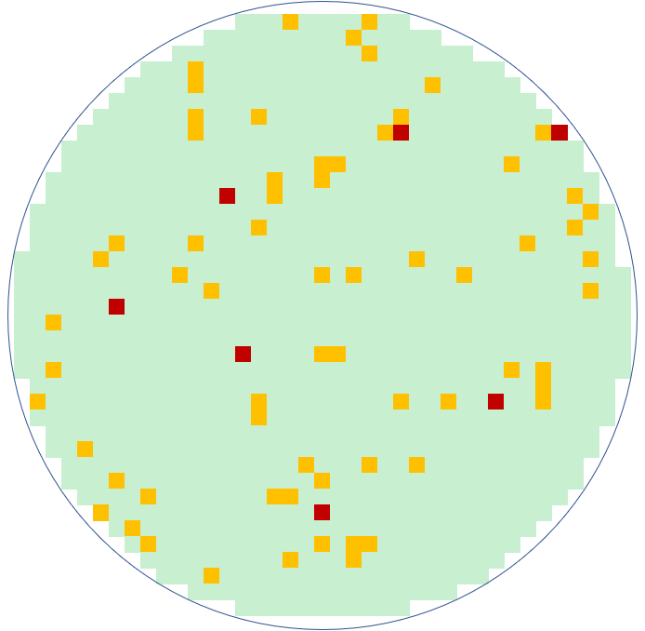
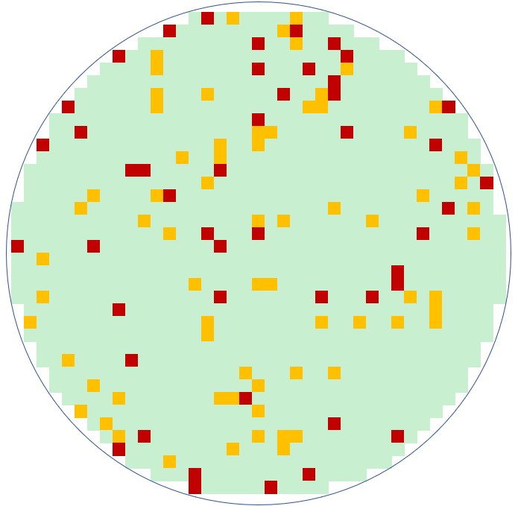
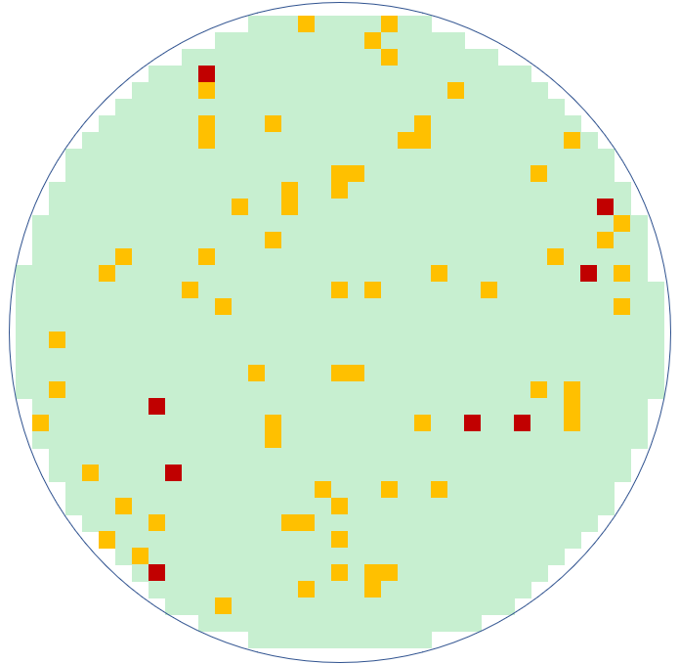
Result Comparison –
Normal Yield Across Sites
Retest Options
Traditional
xREPROBE
First Pass
 | FirstPass | Retest Options
 |  | Traditional | Blind Shift | xREPROBE
Yield | 89.91% | 93.76% | 93.67% | 93.76%
0 | 88.20% | 19 | 18 | 3
1 | 86.16% | 22 | 15 | 4
2 | 89.54% | 16 | 14 | 10
3 | 95.36% | 7 | 7 | 56
4 | 87.59% | 18 | 19 | 2
5 | 89.66% | 15 | 22 | 8
6 | 89.06% | 14 | 16 | 12
7 | 94.49% | 7 | 7 | 23
TD | 161 | 78 | 87 | 69
RedCnt | 47 | 5 | 8 | 7
RedPct | 4.02% | 0.43% | 0.68% | 0.60%
Blind Shift
①: Number represents number of rejects tested
②: Number represents number of touch downs
Test Time
3.8%↓

Slide 14


Result Comparison
Retest Method | Traditional | Blind Shift Site | xREPROBE
Retest Yield | Uses same site to retest Worst recovery on site to site issue | Recovery rate is hard to predict depending on low yield site location Resulting in continued false fails from low yielding sites | Best recovery yield with accurate binning
Retest Time | Standard retest TD | Increase of TD because change site away from optimized stepping Retest time increased due to increase of TD | Optimized and use fewest TD to retest Calculated for each wafer so every retest is optimized

Slide 15
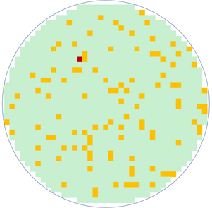
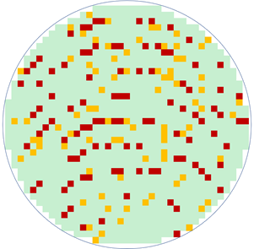
Additional feature: Inline Retest Decision
Next Step
Pass
1st Pass
Yield
Check
Retest Configs
Inline
Retest
Fail
Yield Check Rule:
  Yield
  Soft Bin Limit
  Site to site Yld & SBL
  Pattern recognition
Retest configs:
  Which Bins to retest
  Retest decision:
    Minimize test time?
    Maximize yield?

Slide 16
Case I:
C customer with 16 site setup, high retest rate due to setup

Slide 17
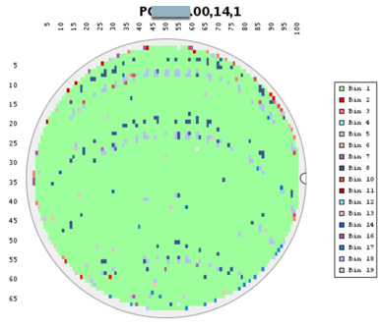
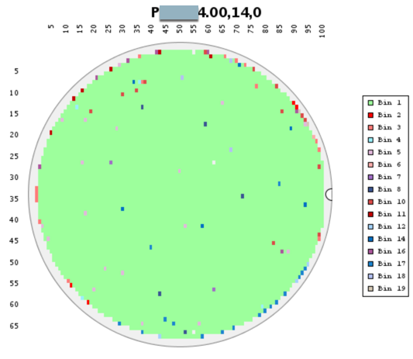
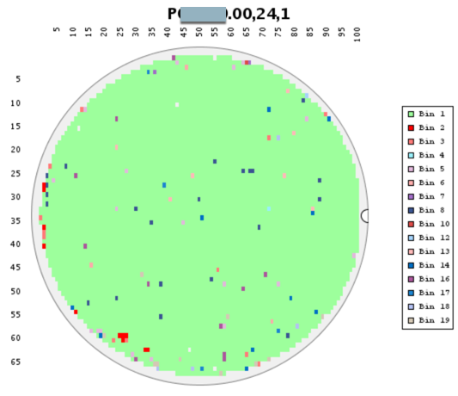
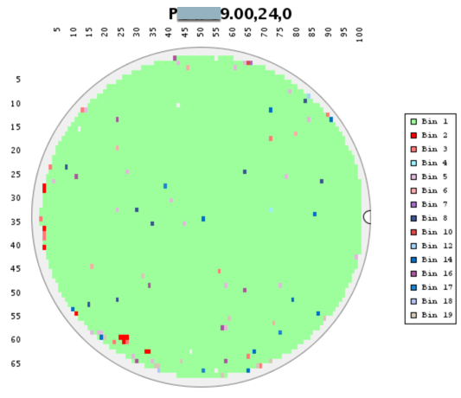
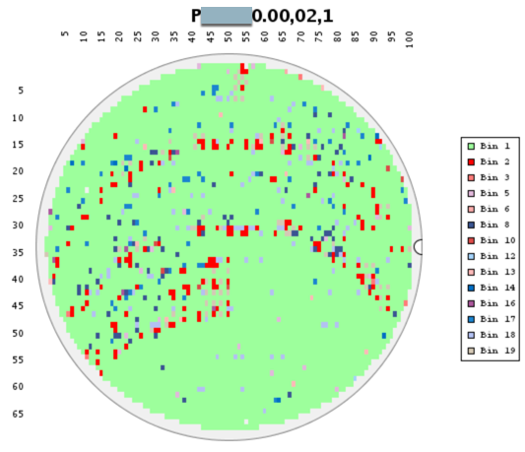
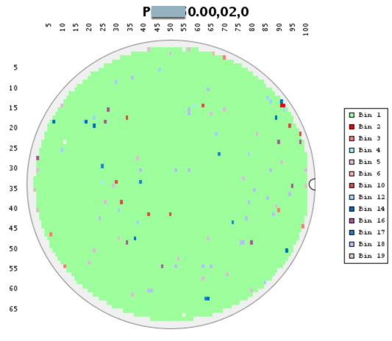
Result on 16 sites
Ran 3 wafers to review results
Saved 2% on test time and wafer show no sign of site to site fail pattern after retest
Wafers | First Yld | Final Yld | Total TD | Traditional Rsc TD | xREPROBE Rsc TD | Rsc % Save | Traditional Total TD | xREPROBE Total TD | Save %
AXXXX4_14 | 93.97% | 98.04% | 396 | 206 | 192 | 6.80% | 602 | 588 | 2.33%
AXXXX9_24 | 97.83% | 98.28% | 396 | 61 | 53 | 13.11% | 457 | 449 | 1.75%
AXXXX0_02 | 89.75% | 98.11% | 396 | 226 | 214 | 5.31% | 622 | 610 | 1.97%
Average | 93.85% | 98.14% | 396 | 164.33 | 153 | 6.89% | 560.33 | 549 | 2.02%

Slide 18
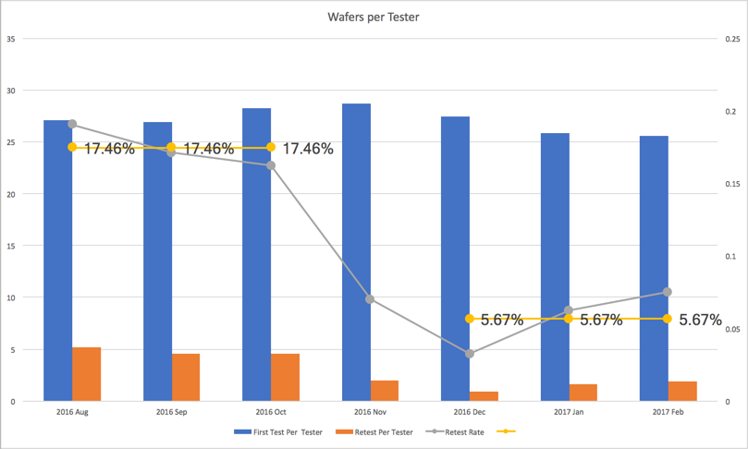
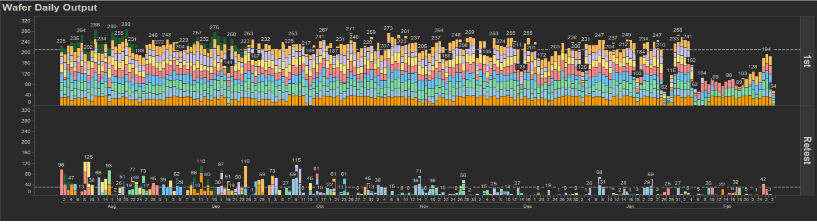
High Volume Production Result
Collected from 4 months, more than 20k wafers
Wafers needing offline retest dropped from 17.4% to 5.67% after implementing shift site reprobe!!!
Traditional Flow
xREPROBE Shift Site Enabled

Slide 19
Case II:
S customer with 54 site setup, long retest time from site efficiency

Slide 20
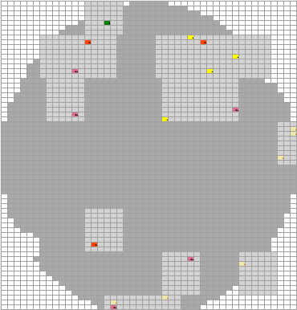
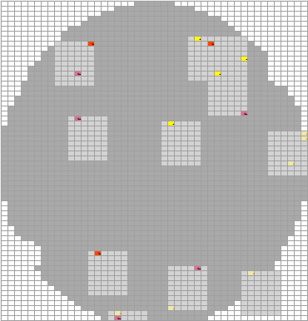
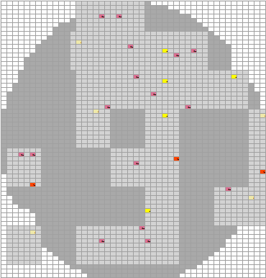


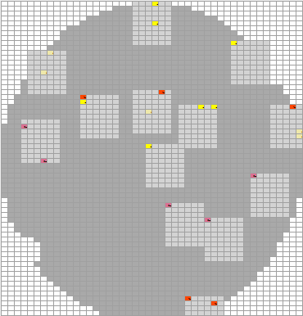
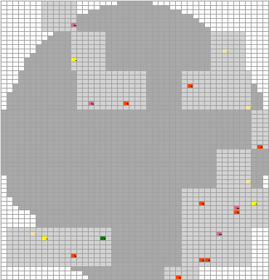
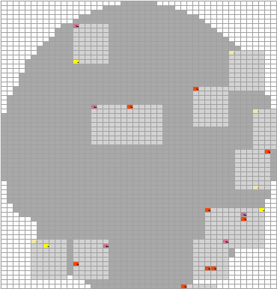
Wafer Result (Traditional -> xREPROBE)
Traditional
xReprobe
Bin 2 Bin
Traditional
xReprobe
Bin 2 Bin
W14 |  | xREPROBE
 |  | 1 | 45 | 72 | 77 | 86 | 103 | 165 | 230 | 235
Regular | 1 | 2301
 | 45 |  | 3
 | 72 |  |  | 2
 | 77 |  |  |  | 4
 | 86 |  |  |  |  | 3
 | 103 |  |  |  |  |  | 1
 | 165 |  |  |  |  |  |  | 2
 | 230 |  |  |  |  |  |  |  | 2
 | 235 |  |  |  |  |  |  |  |  | 1
W15 |  | xREPROBE
 |  | 1 | 45 | 72 | 77 | 86 | 164 | 165 | 230 | 235 | 236
Regular | 1 | 2290
 | 45 |  | 4 |  | 1
 | 72 |  |  | 1
 | 77 |  |  |  | 4
 | 86 |  |  |  |  | 3
 | 164 |  |  |  |  |  | 1
 | 165 |  |  |  |  |  |  | 6
 | 230 | 1 |  |  |  |  |  |  | 1
 | 235 |  |  |  |  |  |  |  |  | 1
 | 236 |  |  |  |  |  |  |  |  |  | 6
W16 |  | xREPROBE
 |  | 1 | 45 | 72 | 76 | 77 | 86 | 165 | 230 | 236
Regular | 1 | 2297 |  |  |  |  | 1
 | 45 |  | 7
 | 72 |  |  | 2
 | 76 |  |  |  | 1
 | 77 |  |  |  |  | 2
 | 86 |  |  |  |  |  | 4
 | 165 |  |  |  |  |  |  | 3
 | 230 |  |  |  |  |  |  |  | 1
 | 236 |  |  |  |  |  |  |  |  | 1
W17 |  | xREPROBE
 |  | 1 | 45 | 76 | 77 | 83 | 86 | 165 | 230
Regular | 1 | 2298 |  |  |  |  |  | 1
 | 45 |  | 3
 | 76 |  |  | 1
 | 77 |  |  |  | 3
 | 83 |  |  |  |  | 1
 | 86 |  |  |  |  |  | 8
 | 230 |  |  |  |  |  |  |  | 1
 | 236

Slide 21
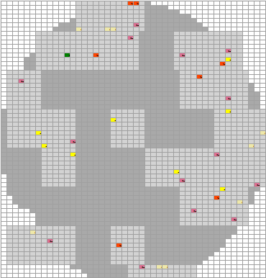

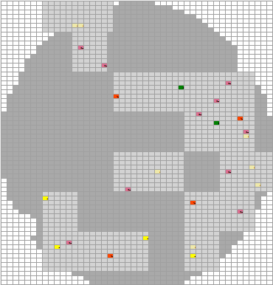
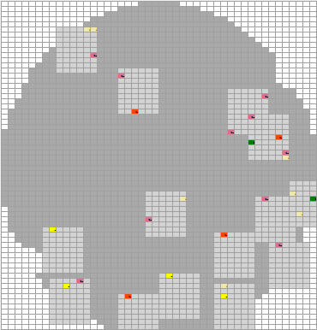
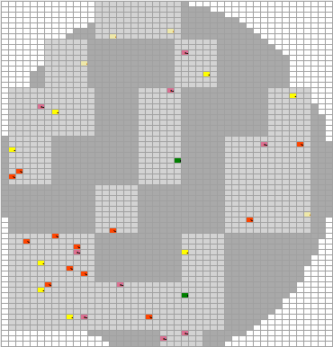
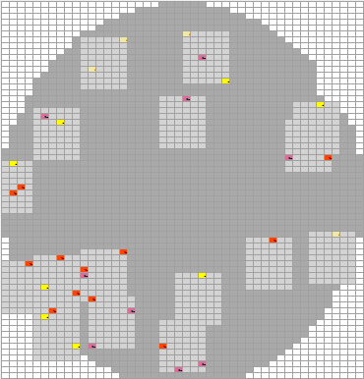
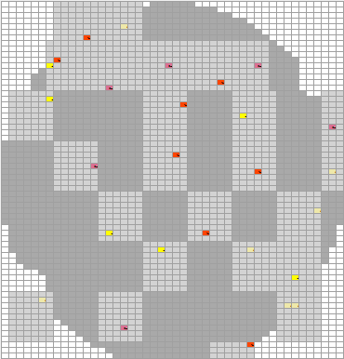
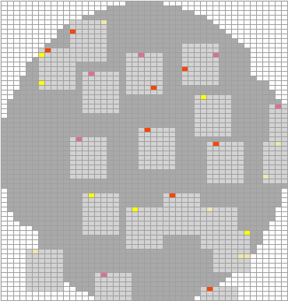
Wafer Result (xREPROBE -> Traditional)
Traditional
xReprobe
Bin 2 Bin
Traditional
xReprobe
Bin 2 Bin
W19 |  | xREPROBE
 |  | 1 | 45 | 46 | 76 | 77 | 83 | 86 | 103 | 165 | 230 | 236
Regular | 1 | 2280 |  |  |  |  |  |  |  | 1
 | 45 |  | 5
 | 46 |  |  | 2
 | 76 |  |  |  | 2
 | 77 |  |  |  |  | 7
 | 83 |  |  |  |  |  | 1
 | 86 |  |  |  |  |  |  | 6
 | 103 |  |  |  |  |  |  |  | 1
 | 165 |  |  |  |  |  |  |  |  | 6
 | 230 |  |  |  |  |  |  |  |  |  | 3
 | 236 |  |  |  |  |  |  |  |  |  |  | 5
W20 |  | xREPROBE
 |  | 1 | 45 | 46 | 77 | 83 | 86 | 165 | 230
Regular | 1 | 2294
 | 45 |  | 3
 | 46 |  |  | 1
 | 77 |  |  |  | 7
 | 83 |  |  |  |  | 1
 | 86 |  |  |  |  |  | 3
 | 165 |  |  |  |  |  |  | 9
 | 230 |  |  |  |  |  |  |  | 1
W22 |  | xREPROBE
 |  | 1 | 45 | 76 | 77 | 83 | 86 | 165 | 230 | 235 | 236
Regular | 1 | 2286
 | 45 |  | 8
 | 76 |  |  | 1
 | 77 |  |  |  | 3
 | 83 |  |  |  |  | 1
 | 86 |  |  |  |  |  | 11
 | 165 |  |  |  |  |  |  | 4
 | 230 |  |  |  |  |  |  |  | 3
 | 235 |  |  |  |  |  |  |  |  | 1
 | 236 |  |  |  |  |  |  |  |  |  | 1
W22 |  | xREPROBE
 |  | 1 | 45 | 77 | 86 | 103 | 165 | 230 | 236
Regular | 1 | 2292
 | 45 |  | 5
 | 77 |  |  | 7
 | 86 |  |  |  | 8
 | 103 |  |  |  |  | 1
 | 165 |  |  |  |  |  | 4
 | 230 |  |  |  |  |  |  | 1
 | 236 |  |  |  |  |  |  |  | 1

Slide 22
Retest Summary
 | STEP | Yield | TD | Tested w <96% | S0 | S1 | S2 | S3 | S4 | S5 | S6 | S7 | S8 | S9 | S10 | S11 | S12 | S13 | S14 | S15 | S16 | S17 | S18 | S19 | S20 | S21 | S22 | S23 | S24 | S25 | S26 | S27 | S28 | S29 | S30 | S31 | S32 | S33 | S34 | S35 | S36 | S37 | S38 | S39 | S40 | S41 | S42 | S43 | S44 | S45 | S46 | S47 | S48 | S49 | S50 | S51 | S52 | S53
W14_Reg | FirstPass | 99.18% | 54 |  | 95% | 100% | 98% | 96% | 100% | 100% | 100% | 100% | 98% | 100% | 100% | 100% | 100% | 98% | 100% | 100% | 100% | 98% | 98% | 100% | 100% | 93% | 98% | 100% | 100% | 100% | 98% | 98% | 98% | 100% | 100% | 100% | 100% | 100% | 100% | 100% | 100% | 100% | 98% | 100% | 100% | 100% | 100% | 100% | 100% | 100% | 100% | 100% | 100% | 98% | 100% | 100% | 100% | 98%
 | Retest | 99.22% | 15 | 1 |  |  |  | 1 |  | 1 |  | 3 | 1 |  | 1 |  | 1 | 1 | 1 |  |  |  |  |  |  |  |  |  | 1 |  |  |  |  |  |  |  |  |  |  |  |  |  |  | 1 |  | 1 | 1 | 1 | 1 |  | 1 | 1 | 1
W14_xTest | FirstPass | 99.22% | 54 |  | 95% | 100% | 98% | 96% | 100% | 100% | 100% | 100% | 98% | 100% | 100% | 100% | 100% | 98% | 100% | 100% | 100% | 98% | 98% | 100% | 100% | 93% | 98% | 100% | 100% | 100% | 98% | 98% | 98% | 100% | 100% | 100% | 100% | 100% | 100% | 100% | 100% | 100% | 98% | 100% | 100% | 100% | 100% | 100% | 100% | 100% | 100% | 100% | 100% | 98% | 100% | 100% | 100% | 100%
 | Retest | 99.22% | 11 | 0 |  | 7 |  |  | 1 | 2 | 1 | 1 |  | 1 |  | 1 |  |  |  |  |  |  |  |  |  |  |  |  |  |  |  |  |  | 1 |  |  |  |  |  |  |  |  |  | 2 |  |  |  | 1 |  |  | 1 |  | 1 |  |  |  |  | 1
W15_Reg | FirstPass | 98.75% | 54 |  | 100% | 100% | 100% | 100% | 100% | 100% | 98% | 98% | 100% | 98% | 100% | 100% | 100% | 98% | 100% | 100% | 98% | 98% | 93% | 100% | 100% | 100% | 95% | 95% | 100% | 98% | 98% | 98% | 100% | 98% | 93% | 100% | 98% | 100% | 100% | 100% | 98% | 100% | 100% | 100% | 100% | 98% | 98% | 100% | 96% | 96% | 98% | 100% | 100% | 100% | 100% | 100% | 100% | 100%
 | Retest | 98.75% | 25 | 5 |  |  | 1 | 1 |  | 1 |  |  | 2 | 2 | 3 |  | 1 | 1 |  | 1 |  | 1 | 1 |  |  |  | 3 |  |  |  |  | 1 | 1 |  | 2 | 2 | 1 |  | 1 |  |  |  |  |  |  |  |  |  |  |  |  |  |  | 1 |  |  | 1 | 1
W15_xTest | FirstPass | 98.71% | 54 |  | 100% | 98% | 100% | 100% | 100% | 100% | 98% | 98% | 100% | 98% | 100% | 100% | 100% | 98% | 100% | 100% | 98% | 98% | 93% | 100% | 100% | 100% | 95% | 95% | 100% | 98% | 98% | 98% | 100% | 98% | 93% | 100% | 98% | 100% | 100% | 100% | 98% | 100% | 100% | 100% | 100% | 98% | 98% | 100% | 96% | 96% | 98% | 100% | 100% | 100% | 100% | 100% | 100% | 100%
 | Retest | 98.79% | 16 | 0 | 9 |  |  | 3 | 2 | 2 | 1 |  | 2 |  |  | 1 | 2 |  | 1 |  | 1 |  |  |  |  |  |  |  |  |  |  |  | 1 |  |  |  |  |  |  | 1 |  | 1 |  |  |  |  |  |  |  |  |  | 3 | 1
W16_Reg | FirstPass | 99.05% | 54 |  | 100% | 95% | 98% | 100% | 100% | 100% | 100% | 100% | 98% | 100% | 100% | 100% | 98% | 100% | 100% | 100% | 98% | 100% | 100% | 98% | 98% | 98% | 98% | 100% | 98% | 98% | 100% | 100% | 98% | 100% | 100% | 98% | 100% | 98% | 100% | 100% | 100% | 98% | 100% | 100% | 100% | 98% | 100% | 98% | 100% | 96% | 100% | 100% | 98% | 100% | 100% | 100% | 100% | 98%
 | Retest | 99.09% | 16 | 0 |  |  | 1 |  | 1 |  | 1 | 1 | 1 |  |  | 1 |  |  | 1 |  | 1 | 1 |  | 1 |  |  |  | 1 |  |  |  | 1 |  | 1 |  | 2 |  |  |  | 1 |  |  |  | 1 | 1 |  | 2 |  |  |  |  | 1 |  |  |  | 1
W16_xTest | FirstPass | 99.05% | 54 |  | 100% | 95% | 98% | 100% | 100% | 100% | 100% | 100% | 98% | 100% | 100% | 100% | 98% | 100% | 100% | 100% | 98% | 100% | 100% | 98% | 98% | 98% | 98% | 100% | 98% | 98% | 100% | 100% | 98% | 100% | 100% | 98% | 100% | 98% | 100% | 100% | 100% | 98% | 100% | 100% | 100% | 98% | 100% | 98% | 100% | 96% | 100% | 100% | 98% | 100% | 100% | 100% | 100% | 98%
 | Retest | 99.05% | 13 | 0 | 7 |  |  | 4 | 1 | 1 | 2 |  |  |  | 1 |  |  |  |  |  |  |  |  |  |  |  |  |  |  |  | 2 | 1 |  |  |  |  |  |  | 1 |  |  |  |  |  | 1 |  |  |  |  |  |  |  |  |  |  | 1
W17_Reg | FirstPass | 99.09% | 54 |  | 100% | 98% | 96% | 98% | 95% | 100% | 100% | 98% | 100% | 98% | 100% | 100% | 100% | 100% | 100% | 100% | 100% | 100% | 98% | 100% | 98% | 100% | 100% | 100% | 98% | 100% | 98% | 100% | 98% | 100% | 100% | 100% | 98% | 98% | 100% | 98% | 100% | 100% | 100% | 100% | 98% | 98% | 100% | 100% | 100% | 100% | 100% | 98% | 100% | 98% | 98% | 100% | 100% | 100%
 | Retest | 99.14% | 18 | 0 |  |  |  |  |  |  | 1 |  |  |  | 1 |  | 1 |  | 1 |  | 1 |  | 1 | 1 |  | 1 |  |  |  |  | 1 | 1 |  |  |  |  |  | 1 |  |  | 1 |  |  |  |  | 1 |  |  | 2 | 1 | 1 | 2 |  | 1 |  |  |  | 1
W17_xTest | FirstPass | 99.09% | 54 |  | 100% | 98% | 96% | 98% | 95% | 100% | 100% | 98% | 100% | 98% | 100% | 100% | 100% | 100% | 100% | 100% | 100% | 100% | 98% | 100% | 98% | 100% | 100% | 100% | 98% | 100% | 98% | 100% | 98% | 100% | 100% | 100% | 98% | 98% | 100% | 98% | 100% | 100% | 100% | 100% | 98% | 98% | 100% | 100% | 100% | 100% | 100% | 98% | 100% | 98% | 98% | 100% | 100% | 100%
 | Retest | 99.09% | 13 | 0 | 9 |  |  |  |  | 3 |  |  | 2 |  |  | 1 |  |  | 1 |  |  |  |  |  |  |  |  |  |  |  |  |  |  |  | 1 |  |  |  |  |  |  |  | 1 | 1 |  |  |  |  |  | 1 |  |  | 1 |  |  | 1
W19_Reg | FirstPass | 98.32% | 54 |  | 100% | 95% | 98% | 98% | 100% | 98% | 100% | 100% | 93% | 93% | 100% | 100% | 100% | 98% | 98% | 98% | 95% | 100% | 95% | 98% | 98% | 100% | 100% | 98% | 98% | 100% | 95% | 100% | 98% | 98% | 98% | 100% | 100% | 98% | 100% | 100% | 100% | 100% | 100% | 98% | 100% | 98% | 98% | 93% | 100% | 98% | 95% | 100% | 100% | 100% | 100% | 100% | 98% | 98%
 | Retest | 98.36% | 27 | 4 | 1 | 1 | 2 |  |  | 1 | 1 |  |  | 1 | 2 | 1 | 2 |  | 1 | 1 | 1 |  |  | 1 |  |  | 1 |  |  | 1 |  | 1 |  |  |  | 1 | 2 |  | 1 | 3 |  |  | 1 | 1 |  |  | 1 |  | 1 | 1 | 1 | 1 | 4 | 1 |  |  |  | 1
W19_xTest | FirstPass | 98.28% | 54 |  | 100% | 95% | 98% | 98% | 100% | 98% | 100% | 100% | 93% | 93% | 100% | 100% | 100% | 95% | 98% | 98% | 95% | 100% | 95% | 98% | 98% | 100% | 100% | 98% | 98% | 100% | 95% | 100% | 98% | 98% | 98% | 100% | 100% | 98% | 100% | 100% | 100% | 100% | 100% | 98% | 100% | 98% | 98% | 95% | 100% | 98% | 95% | 100% | 100% | 100% | 100% | 100% | 98% | 95%
 | Retest | 98.32% | 18 | 1 | 6 |  |  |  | 4 | 1 | 2 | 1 |  |  | 2 | 5 | 2 |  |  |  |  | 2 |  | 1 |  | 1 | 2 |  |  | 2 |  | 2 |  | 1 |  |  |  | 1 | 1 | 2 | 2 | 1 |  |  |  |  |  |  |  |  |  |  | 1 | 1 |  | 1 | 1 | 1
W20_Reg | FirstPass | 98.84% | 54 |  | 98% | 100% | 96% | 98% | 100% | 100% | 100% | 100% | 100% | 100% | 98% | 100% | 100% | 100% | 100% | 100% | 98% | 100% | 100% | 98% | 98% | 100% | 100% | 98% | 98% | 98% | 100% | 96% | 100% | 100% | 100% | 95% | 100% | 95% | 98% | 100% | 98% | 100% | 100% | 95% | 100% | 98% | 98% | 98% | 98% | 98% | 100% | 100% | 100% | 98% | 100% | 100% | 100% | 100%
 | Retest | 98.92% | 20 | 3 |  |  | 1 |  |  |  | 1 |  |  | 1 |  | 1 |  | 2 |  |  | 1 | 1 |  | 2 | 1 |  |  | 2 |  | 2 |  | 1 | 1 |  | 1 | 1 |  |  | 1 | 1 |  |  |  |  |  | 1 | 2 |  |  |  |  | 2 |  |  | 1
W20_xTest | FirstPass | 98.84% | 54 |  | 98% | 100% | 96% | 98% | 100% | 100% | 100% | 100% | 100% | 100% | 98% | 100% | 100% | 100% | 100% | 100% | 98% | 100% | 100% | 98% | 98% | 100% | 100% | 98% | 98% | 98% | 100% | 96% | 100% | 100% | 100% | 98% | 100% | 95% | 98% | 100% | 98% | 100% | 100% | 95% | 98% | 98% | 98% | 98% | 98% | 98% | 100% | 100% | 100% | 98% | 100% | 100% | 100% | 100%
 | Retest | 98.92% | 14 | 1 | 1 | 7 |  |  | 2 | 1 | 1 |  | 1 |  |  | 2 | 1 | 1 |  |  |  |  |  |  |  | 1 |  |  |  |  |  |  | 1 |  | 2 |  |  | 1 |  | 1 |  | 1 |  |  |  |  |  |  |  |  |  | 1 | 1 |  | 1 |  |  | 1
W22_Reg | FirstPass | 98.49% | 54 |  | 98% | 98% | 98% | 100% | 100% | 100% | 100% | 100% | 100% | 100% | 98% | 98% | 98% | 98% | 98% | 100% | 100% | 95% | 95% | 98% | 98% | 100% | 98% | 98% | 100% | 100% | 95% | 98% | 100% | 98% | 98% | 100% | 98% | 100% | 100% | 98% | 100% | 95% | 98% | 100% | 100% | 100% | 98% | 98% | 100% | 100% | 100% | 100% | 95% | 100% | 100% | 95% | 95% | 98%
 | Retest | 98.58% | 24 | 3 | 1 |  |  | 2 | 1 | 1 | 1 |  | 1 | 1 | 2 | 1 | 2 | 1 |  | 1 |  |  | 1 |  |  | 1 | 1 |  | 1 |  |  |  |  | 2 |  |  |  |  | 1 | 1 |  | 2 | 2 | 1 | 2 |  | 1 |  |  |  | 2 |  |  |  | 2
W22_xTest | FirstPass | 98.58% | 54 |  | 98% | 98% | 98% | 100% | 100% | 100% | 100% | 100% | 100% | 100% | 98% | 98% | 98% | 98% | 98% | 100% | 100% | 95% | 95% | 98% | 98% | 100% | 98% | 98% | 100% | 100% | 98% | 98% | 100% | 98% | 98% | 100% | 98% | 100% | 100% | 98% | 100% | 98% | 98% | 100% | 100% | 100% | 98% | 98% | 100% | 100% | 100% | 100% | 95% | 100% | 100% | 95% | 95% | 98%
 | Retest | 98.58% | 16 | 3 | 2 |  | 1 | 8 |  | 2 |  | 2 |  |  |  |  |  |  |  | 1 |  | 1 | 1 |  |  |  |  |  | 2 |  | 1 |  | 1 | 1 |  | 2 |  | 1 |  |  | 1 |  |  |  |  | 3 |  |  |  |  |  | 1 | 1 | 1 | 1 |  |  | 1
W23_Reg | FirstPass | 98.84% | 54 |  | 98% | 100% | 100% | 98% | 98% | 100% | 100% | 98% | 100% | 98% | 100% | 100% | 100% | 98% | 100% | 100% | 100% | 100% | 98% | 98% | 100% | 100% | 95% | 100% | 98% | 98% | 100% | 98% | 98% | 100% | 100% | 98% | 100% | 98% | 100% | 100% | 95% | 98% | 98% | 98% | 100% | 100% | 100% | 100% | 100% | 98% | 100% | 98% | 100% | 100% | 100% | 98% | 98% | 95%
 | Retest | 98.84% | 25 | 0 |  |  |  |  |  | 1 |  |  | 2 |  | 1 | 1 |  | 1 | 1 |  | 1 | 1 |  | 1 |  |  |  | 1 | 1 | 1 |  |  | 2 | 1 |  | 1 |  | 1 |  |  |  | 1 | 1 | 2 |  |  |  | 1 | 1 |  |  | 1 |  |  | 1 |  | 1
W23_xTest | FirstPass | 98.84% | 54 |  | 98% | 100% | 100% | 98% | 98% | 100% | 100% | 98% | 100% | 98% | 100% | 100% | 100% | 98% | 100% | 100% | 100% | 100% | 98% | 98% | 100% | 100% | 95% | 100% | 98% | 98% | 100% | 98% | 98% | 100% | 100% | 98% | 100% | 98% | 100% | 100% | 95% | 98% | 98% | 98% | 100% | 100% | 100% | 100% | 100% | 98% | 100% | 98% | 100% | 100% | 100% | 98% | 98% | 95%
 | Retest | 98.84% | 19 | 0 |  | 14 | 2 |  |  | 2 | 1 |  |  |  |  |  | 1 |  |  |  |  | 1 |  |  |  |  |  |  |  |  |  |  |  |  | 1 |  |  |  | 1 | 1 |  |  |  |  |  |  | 2 |  |  |  | 1 |  |  | 1
Summ_Reg | FirstPass | 98.82% | 54 |  | 99% | 98% | 98% | 98% | 99% | 100% | 100% | 99% | 99% | 98% | 99% | 100% | 99% | 99% | 99% | 100% | 99% | 99% | 97% | 99% | 99% | 99% | 98% | 99% | 98% | 99% | 98% | 98% | 99% | 99% | 98% | 99% | 99% | 98% | 100% | 99% | 99% | 99% | 99% | 99% | 100% | 99% | 99% | 98% | 99% | 98% | 99% | 99% | 99% | 99% | 100% | 99% | 99% | 98%
 | Retest | 98.86% | 21.25 |  | 1.00 | 1.00 | 1.25 | 1.33 | 1.00 | 1.00 | 1.00 | 2.00 | 1.40 | 1.25 | 1.67 | 1.00 | 1.40 | 1.20 | 1.00 | 1.00 | 1.00 | 1.00 | 1.00 | 1.20 | 1.00 | 1.00 | 1.67 | 1.33 | 1.00 | 1.33 | 1.00 | 1.00 | 1.33 | 1.33 | 1.50 | 1.40 | 1.50 | 1.00 | 1.00 | 1.50 | 1.00 | 1.50 | 1.33 | 1.20 | 1.50 | 1.00 | 1.40 | 1.00 | 1.25 | 1.00 | 1.25 | 1.33 | 2.50 | 1.00 | 1.33 | 1.00 | 1.00 | 1.00
Summ_xTest | FirstPass | 98.83% | 54 |  | 99% | 98% | 98% | 98% | 99% | 100% | 100% | 99% | 99% | 98% | 99% | 100% | 99% | 98% | 99% | 100% | 99% | 99% | 97% | 99% | 99% | 99% | 98% | 99% | 98% | 99% | 98% | 98% | 99% | 99% | 98% | 99% | 99% | 98% | 100% | 99% | 99% | 99% | 99% | 99% | 99% | 99% | 99% | 99% | 99% | 98% | 99% | 99% | 99% | 99% | 100% | 99% | 99% | 98%
 | Retest | 98.85% | 15.00 |  | 5.67 | 9.33 | 1.50 | 5.00 | 2.00 | 1.75 | 1.33 | 1.33 | 1.67 | 1.00 | 1.50 | 2.00 | 1.50 | 1.00 | 1.00 | 1.00 | 1.00 | 1.33 | 1.00 | 1.00 |  | 1.00 | 2.00 |  | 2.00 | 2.00 | 1.50 | 1.50 | 1.00 | 1.00 | 1.33 | 2.00 |  | 1.00 | 1.00 | 1.25 | 1.50 | 1.00 | 1.00 | 1.50 | 1.00 | 3.00 | 2.00 | 1.00 |  | 1.00 | 1.00 | 1.67 | 1.00 | 1.00 | 1.00 | 1.00 | 1.00 | 1.00
Yield is good, no problematic sites
xREPROBE uses fewer sites yielded <96% on first pass

Slide 23
Test Time Summary
 |  | Touch Down | 1st Retest Index | Index | Test Time | Index+Test | Total | Diff % | Note
W14_Reg | 1st Pass | 54 | N/A | 1.14 | 6.17 | 7.32 | 591.16
 | Reprobe | 15 | 1.61 | 0.78 | 2.53 | 3.30
W14_xTest | 1st Pass | 54 | N/A | 1.01 | 6.12 | 7.14 | 520.64 | 11.93% | total excluded 100s cleaning
 | Reprobe | 11 | 1.54 | 0.64 | 2.85 | 3.49
W19_Reg | 1st Pass | 54 | N/A | 1.21 | 6.20 | 7.41 | 663.42
 | Reprobe | 27 | 1.60 | 0.68 | 2.19 | 2.86
W19_xTest | 1st Pass | 54 | N/A | 1.01 | 6.18 | 7.19 | 548.33 | 17.35%
 | Reprobe | 18 | 2.52 | 0.58 | 2.69 | 3.26
W15_Reg | 1st Pass | 54 | N/A | 1.13 | 6.12 | 7.25 | 608.51
 | Reprobe | 25 | 1.61 | 0.87 | 2.26 | 3.13
W15_xTest | 1st Pass | 54 | N/A | 1.01 | 6.19 | 7.20 | 508.03 | 16.51% | total excluded 240s cleaning
 | Reprobe | 16 | 2.55 | 0.58 | 3.08 | 3.66
W16_Reg | 1st Pass | 54 | N/A | 0.70 | 6.07 | 6.77 | 520.79 |  | total excluded 100s cleaning
 | Reprobe | 16 | 1.61 | 0.73 | 2.32 | 3.06
W16_xTest | 1st Pass | 54 | N/A | 1.06 | 6.09 | 7.15 | 493.80 | 5.18%
 | Reprobe | 13 | 2.40 | 0.82 | 1.84 | 2.66
W17_Reg | 1st Pass | 54 | N/A | 0.71 | 6.05 | 6.76 | 518.47 |  | total excluded 100s cleaning
 | Reprobe | 18 | 1.60 | 0.89 | 1.88 | 2.77
W17_xTest | 1st Pass | 54 | N/A | 1.10 | 6.09 | 7.19 | 502.39 | 3.10% | total excluded 100s cleaning
 | Reprobe | 13 | 2.62 | 0.63 | 2.04 | 2.66
W20_Reg | 1st Pass | 54 | N/A | 1.15 | 6.12 | 7.27 | 574.45 |  | total excluded 100s cleaning
 | Reprobe | 20 | 3.42 | 0.68 | 1.99 | 2.67
W20_xTest | 1st Pass | 54 | N/A | 1.02 | 6.12 | 7.14 | 510.70 | 11.10% | total excluded 100s cleaning
 | Reprobe | 14 | 2.66 | 0.57 | 2.60 | 3.17
W22_Reg | 1st Pass | 54 | N/A | 1.14 | 6.15 | 7.29 | 602.84 |  | total excluded 100s cleaning
 | Reprobe | 24 | 4.07 | 0.71 | 2.60 | 3.31
W22_xTest | 1st Pass | 54 | N/A | 1.01 | 6.12 | 7.13 | 516.08 | 14.39%
 | Reprobe | 16 | 2.55 | 0.74 | 2.80 | 3.54
W23_Reg | 1st Pass | 54 | N/A | 1.19 | 6.10 | 7.29 | 562.71 |  | total excluded 100s cleaning
 | Reprobe | 25 | 3.49 | 0.72 | 1.47 | 2.19
W23_xTest | 1st Pass | 54 | N/A | 1.06 | 6.09 | 7.15 | 513.52 | 8.74% | total excluded 100s cleaning
 | Reprobe | 19 | 2.68 | 0.75 | 1.67 | 2.42
Avg_Reg | 1st Pass | 54 | N/A | 1.05 | 6.12 | 7.17 | 580.29
 | Reprobe | 21.25 | 2.38 | 0.76 | 2.15 | 2.91
Avg_xTest | 1st Pass | 54 | N/A | 1.03 | 6.13 | 7.16 | 514.19 | 11.39%
 | Reprobe | 15.00 | 2.44 | 0.66 | 2.45 | 3.11
All wafers reprobed with xREPROBE shows fewer TD count of reprobe
Index time on regular are unstable, some longer and some shorter, xREPROBE more consistent and mostly shorter than regular
Longer test time on xREPROBE is reasonable due to xREPROBE tested more rejects per touchdown during reprobe
Average saving of 11.39% on probing a wafer!

Slide 24
Trail Run Summary
Longer index time was observed on correlation wafer and first two wafers, program was improved and prober setting updated to met similar or better index time from normal reprobe
Did not met site to site setup issue, hence full xREPROBE capability not demonstrated
Test Time saving of 11.39% (or 66.1sec) per wafer on 8 wafers trail run! Or equal to $0.92 saving per wafer
  (Calculation assumed on hour rate of $50)

Slide 25
xCLEANING

Slide 26
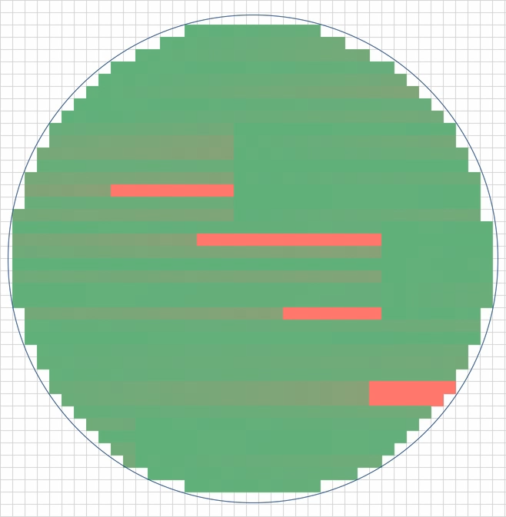
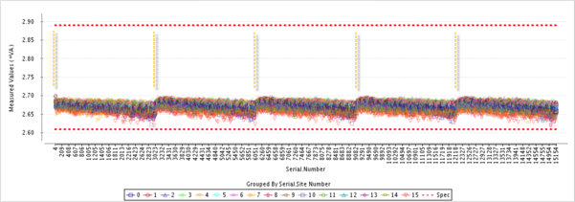
Traditional Cleaning
Fixed cleaning interval by touch down counts
Issue:
  If cleaning not effective across all sites, will cause yield loss until next cleaning cycle
  If set too aggressively, causing wafer test time increased, cleaning media wasted and probe life time reduced.
Example of contact sensitive parameter:

Slide 27

xCLEANING
Provide cleaning options base on special binning control or parameter readings beyond or in addition to traditional cleaning
Steps:
  Find parameters or bins easily affected by contact quality
  Setup cleaning recipe based on SPC controls for identified parameters or bins
Example of xCLEANING:

Slide 28
xSETUP

Slide 29
Traditional Prober Setup
Setup procedure:
  Use prober feature to align and setup contact height
  Use correlation wafer or production wafer to find physical contact height (in some cases this step may be skipped)
  Apply a fixed overdrive
  Verify Bin-1
  Start production
Issue:
  Hardware contact height may not be ideal and planarity not actively analyzed
  No correlation performed
  Once production is started, height setting is not actively optimized

Slide 30
New Requests for Prober Setup
Planarity check
  Find first to last contact height to determine if setup is stable enough for volume production
Contact Z height monitor
  Monitor prober Z height setting along the production to detect any abnormal setup condition, record prober setup in real time to provide traceability
Correlation wafer data checkout
  Use correlation wafer to check setup condition. Determine correlation pass or fail from comparing result to original correlation wafer’s data
Gauge Repeatability and Reproducibility
  GRR is a common way to check site to site, tester to tester, system to system difference but checking a same device on different setup

Slide 31
xSETUP
Prober
HW Setup
xSETUP procedure:
Auto Z at setup:
  Prober performs auto Z during setup
  Reports system planarity after auto Z completion
  Rejects for planarity out of limit or setup final over travel
Perform correlation run by designated rule, or perform GRR
  Correlation run:
    Automated select region and number of dies for prober run, and determine correlation pass or fail automatically. Rule and pass/fail judgement can be based on product configuration file
  GRR:
    Similar to correlation run, also run, report pass/fail result and data automatically.
Adjust over travel during production:
  Re-perform auto Z on every lot or required frequency to adjust contact height
  Results are recorded so trends can be reviewed offline to identify prober-driven planarity issues such as headstage, wafer chuck, and cleaning chuck effects.
Auto Z
Correlation/GRR
Setup new Lot
Auto Z
Auto Height Adjust
Lot Complete

Slide 32
xDATA

Slide 33
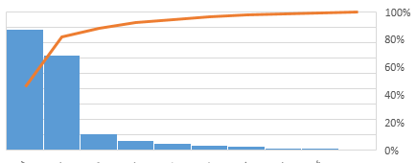
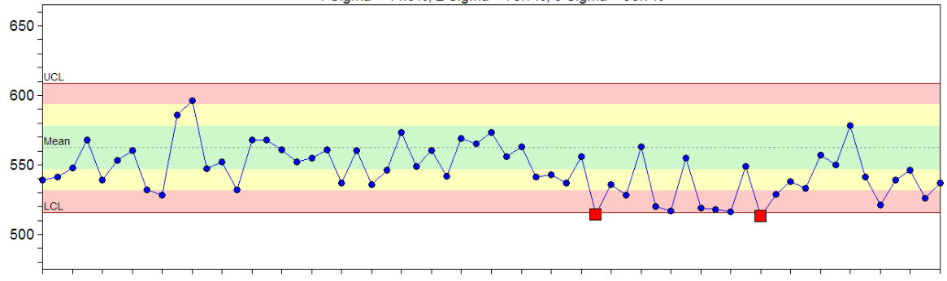
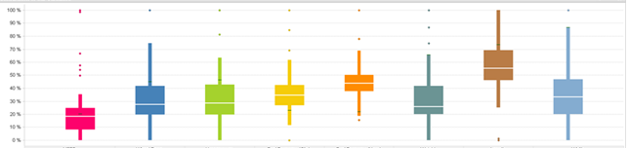
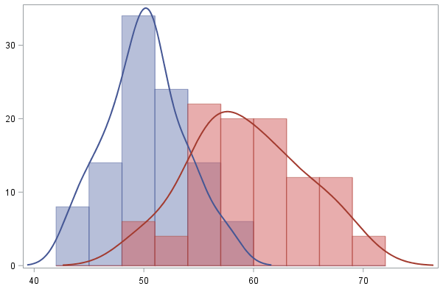


Data Flow
1 HR
6 HRs
24 HRs
Tester
STDF
MES
Test House
Data Server
Yield/Bin Judgement
Hold Disposition
Map System
Handler/
Prober
BinMap
BinSum
Data Analysis
Design House
Data Server

Slide 34
New xData Flow
< 30 Mins
< 60 Mins
Tester
STDF
MES
Test House
Data Server
Yield/Bin Judgement
Hold Disposition
Map System
Handler/
Prober
BinMap
BinSum
Data Analysis
Design House
Data Server

Slide 35
Conclusion

Slide 36
What can xTEST Do for You?
xREPROBE:
  Reduce Test Time
  Improve COEE (Chargeable Overall Equipment Efficiency) by reducing rescreen tester hours
  Reach best yield at initial stage, reduce engineer time for review and disposition
  Improve Overall Yield
  Improve cycle time
  Decrease hardware inventory by optimizing throughput and utilization/hardware setup
xCLEANING:
  Reduce Test Time / improve throughput from reducing cleaning
  Improve Yield from predicted cleaning
  Increase probe life and reduce cleaning media cost by cleaning only when necessary
xSETUP:
  Prevent pad/bump damage to ensure quality
  Setup improvement to improve yield
  Increase probe life by optimizing over travel
xDATA:
  Monitor and analyze production issues like setup stability, equipment OEE and material issue
  Real time data streaming to any database for real time system monitor

Slide 37



ＴＨＡＮＫ ＹＯＵ
Please contact us for more detail!
+886227472644
sales@teslence.com
www.teslence.com

